Slide 1
COMPUTER NETWORKS
Assignment 2 part 1 ( video + pcap file)

Slide 2
01
INTRODUCTION
Assignment 2

Slide 3
Flow Forwarding
Learning about the decisions to forward flows of packet and the information that is kept at network devices that make forwarding decisions

Slide 4
Open Flow Protocol
Controller
Determine the path of network packets across the network
Routers/switches
OpenFlow allows remote administration of switch/routers packet forwarding tables by adding , modifying and removing packet matching rules and actions

Slide 5
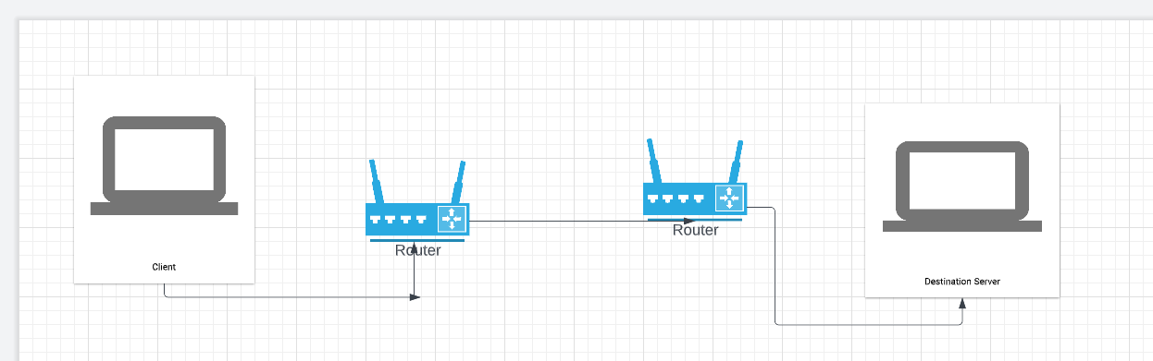
Initial design
My initial design :
Client
Forwarding Service
Router (Switcher)
Destination Server

Slide 6
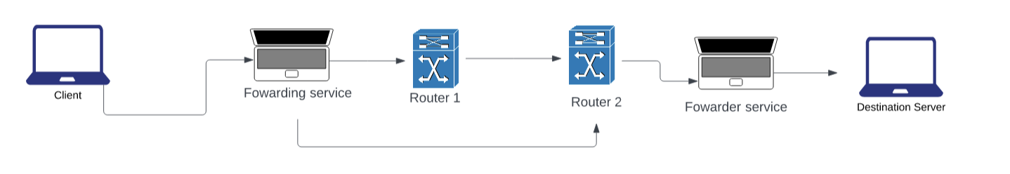
Topology
For the time being the controller is still being constructed. Instead, I have hard coded functions and used a forwarding service. When the user inputs a message, it transmits to one node and then to a router. The router is responsible for carrying the message to other remaining routers. And finally, it will be sent to the destination which is our server . By this it means that forwarding functionality of the network elements is stable and allows for basic communication between two endpoints ( server and client)

Slide 7
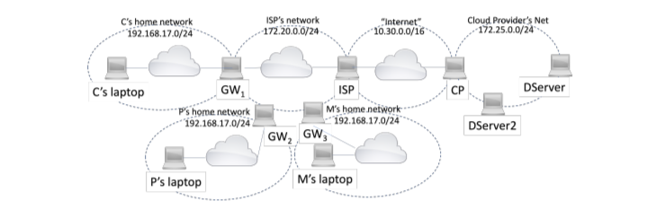
What I am trying to achieve
Number of services to be started in the network pf a cloud provides and a number of employees to use applications to communicate with these services at the same time

Slide 8
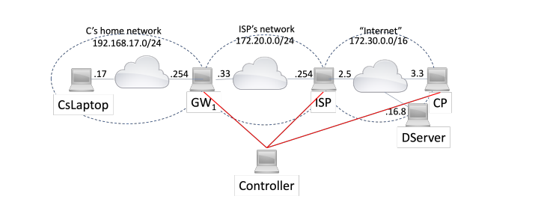
Explanation
My implementation of forwarding services needs to be able to handle to a number of concurrent flows originating from networks of end users and direct these flows to an from a number of services.

Slide 9
Thanks for listening
Aziz

